Slide 1
Magneto-Optical Faraday and Kerr Effects in Topological Insulator Films
Wang-K Tse & A. H. MacDonald
University of Texas, Austin
arXiv:1108.3858
Journal Club Seminar: Suhas Gangadharaiah

Slide 2
Outline
Kerr and Faraday effect.
These effects in the Topological-insulator context:
When time reversal symmetry is broken →
1. Thin film topological insulator: Universal features
2. and thick film topological insulator : Universal features

Slide 3
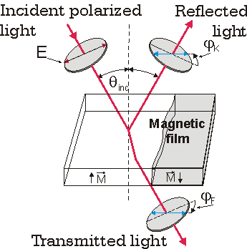
Faraday and Kerr Effects
Kerr Effect
Change in the axis of polarization
For reflected light: Kerr Effect
For transmitted light: Faraday Effect
Effects observed in non-linear medium or on materials with surface
or bulk currents.
Faraday Effect

Slide 4
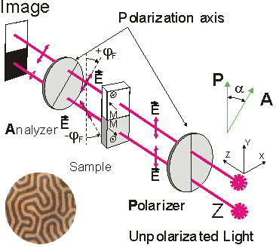
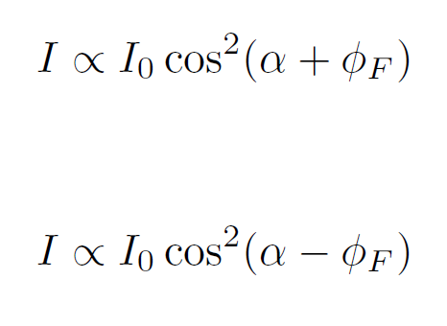
Application: Faraday Kerr effect
Faraday effect: Distinguishes Magnetic domains
Difference in intensity gives domain contrast.

Slide 5
Application: Kerr effect
Spin hall effect: Opposite spins accumulate on different ends.
Light reflected from up-spin and down-spin electrons have their axis rotated in opposite directions.
Elucidating : the spin hall effect
Y. K. Kato, R. C. Myers, A. C. Gossard, D. D. Awschalom, Science Express 1105514 (2004)

Slide 6


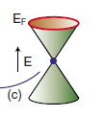

Topological Insulator
Energy spectrum
Surface
Bulk is gapped.
Surface
Surface is gapless:
Coupling to a ferromagnet : Breaks time reversal symmetry
Gap opens up

Slide 7
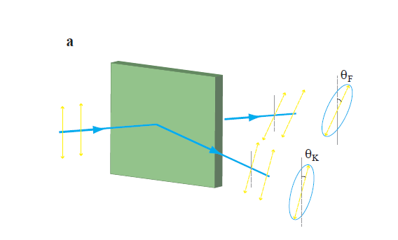
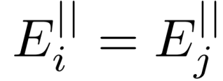

Technical details on obtaining
Kerr and Faraday angles:
Maxwell’s equation:
Boundary conditions from Maxwell’s equation:
Surface conductivity needs to be determined!

Slide 8
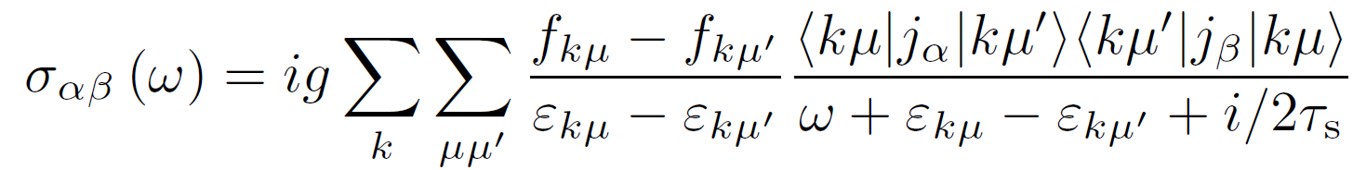
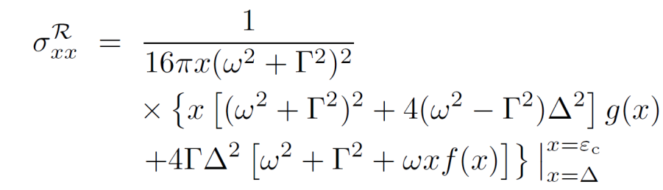
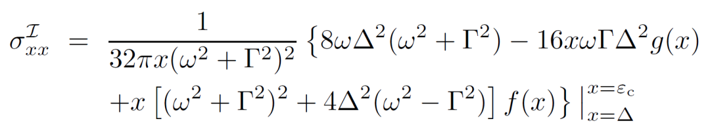


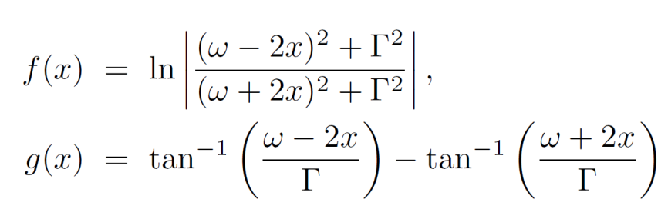
Optical Conductivity:
Kubo formula for current-current correlation function: In the absence of magnetic field
Full form of the Conductivity

Slide 9



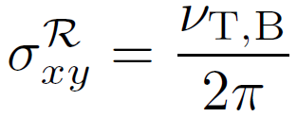
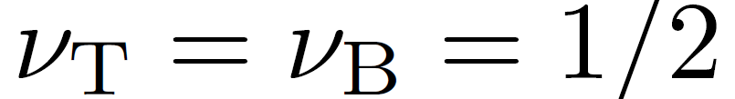
Optical Conductivity: Main result
Low frequency regime.
Weak impurity regime.

Slide 10
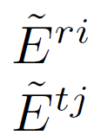
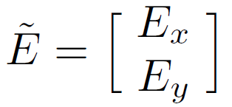
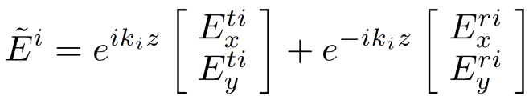

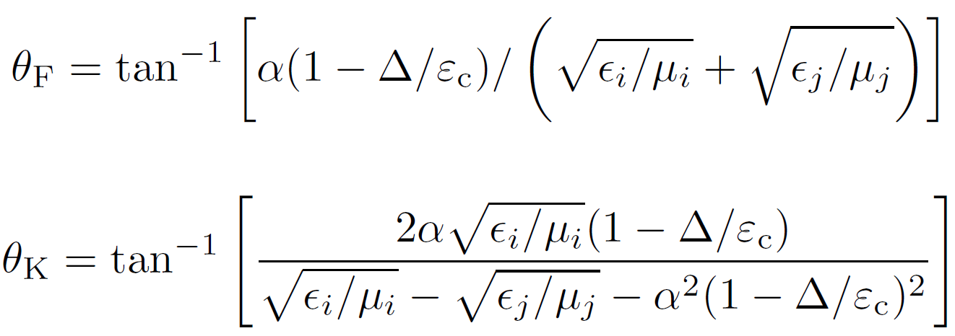







Light propagation through: Vacuum-TI
The angles depends on the material properties

Slide 11




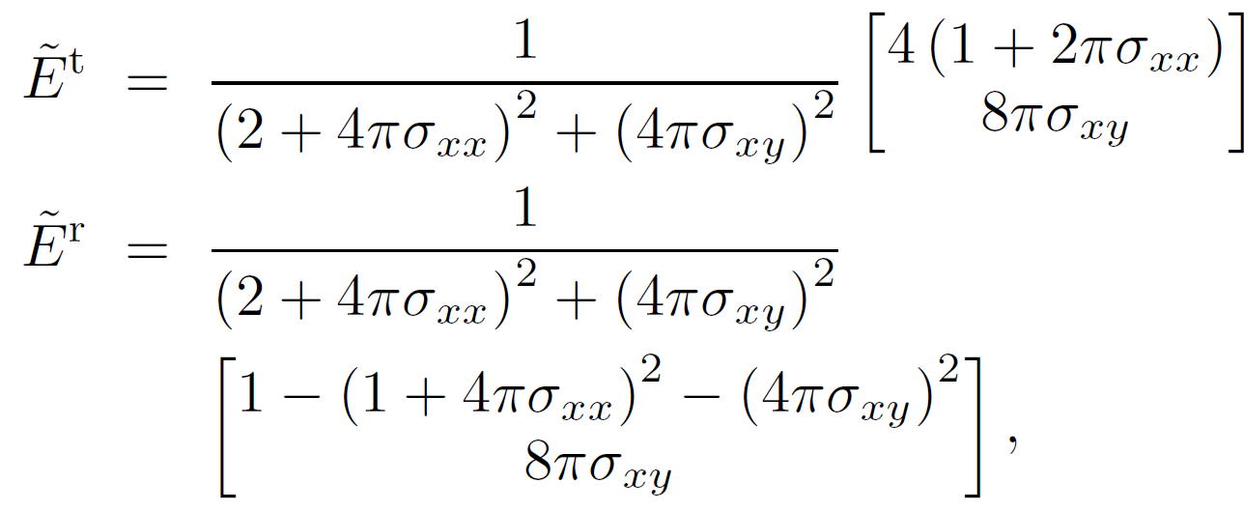
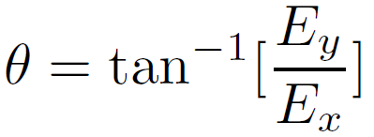



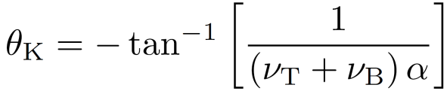
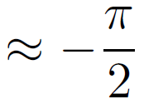


Light propagation through a thin TI film:
Thin film condition:
Ampere’s Law:
Continuity of electric field:

Slide 12




Light propagation through a thick film:
In general Faraday and Kerr angles are not universal. Depends strongly on dielectric constant of the TI bulk.
Universal features:
If &
Dimension is a non-zero integer
multiple of the half wave-length inside
the film.
If

Slide 13
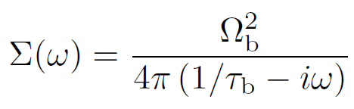

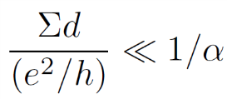
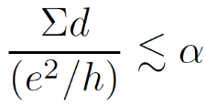


Bulk Contribution- Thin film
Free carriers due to “unintentional” doping; lead to bulk conductivity
Longitudinal bulk conductivity
Effects to the universal features :
Negligible for Faraday:
Negligible for Kerr:
Carrier density smaller than:

Slide 14
Conclusion
Faraday and Kerr effect exhibit universal features (independent of the bulk dielectric properties ) :
If the dimension of the topological insulator is shorter than the
electromagnetic wavelength, or,
if the dimension is a non-zero integer multiple of the half wave-length.

